Slide 1
BCC Final Iteration
Mark Fuller
Kevin Kulda
Connor Woodahl
Dr. Cerny
Software Engineering 1
04-DEC-2019
Project Repository: https://github.com/MarkFuller1/BNU

Slide 2
BCC Iteration 1

Slide 3
Baylor Class Connect
BCC is a tool used by students to rate their current teachers, view reviews of future teachers and contact previous students who havehad those teachers.

Slide 4
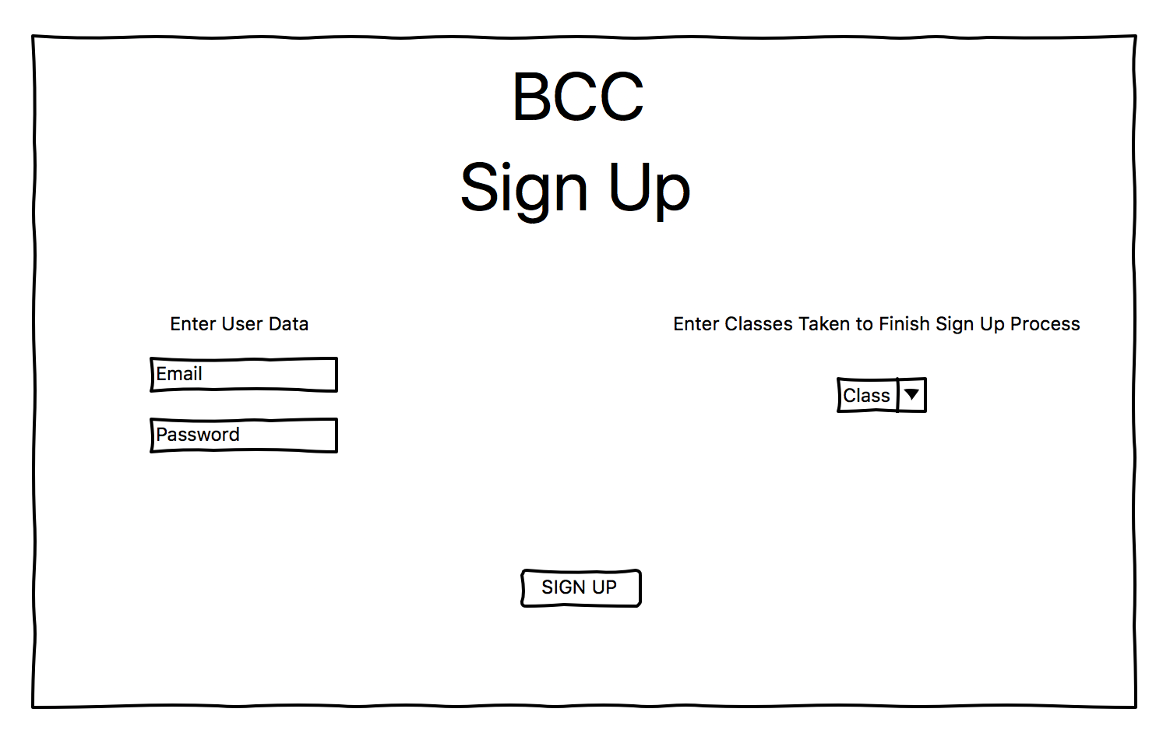
Wireframes

Slide 5
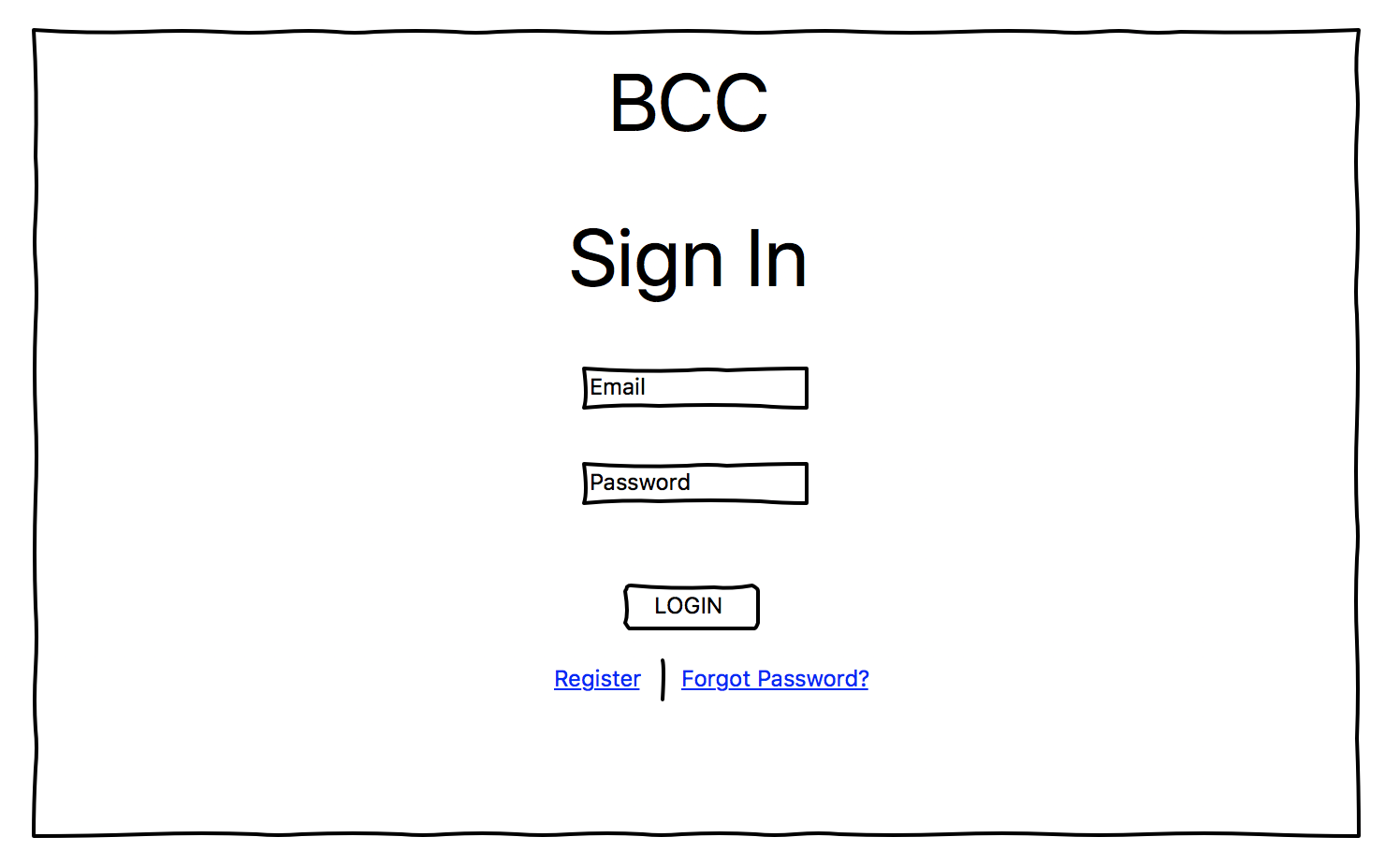
Wireframes

Slide 6
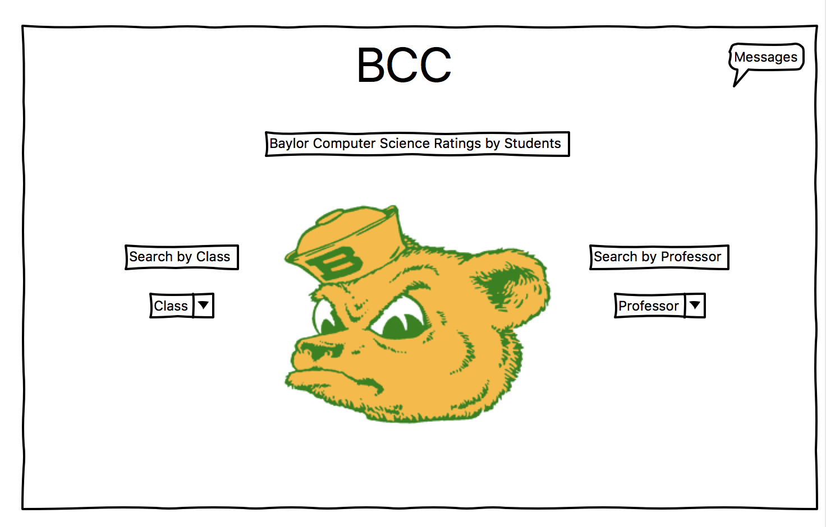
Wireframes

Slide 7
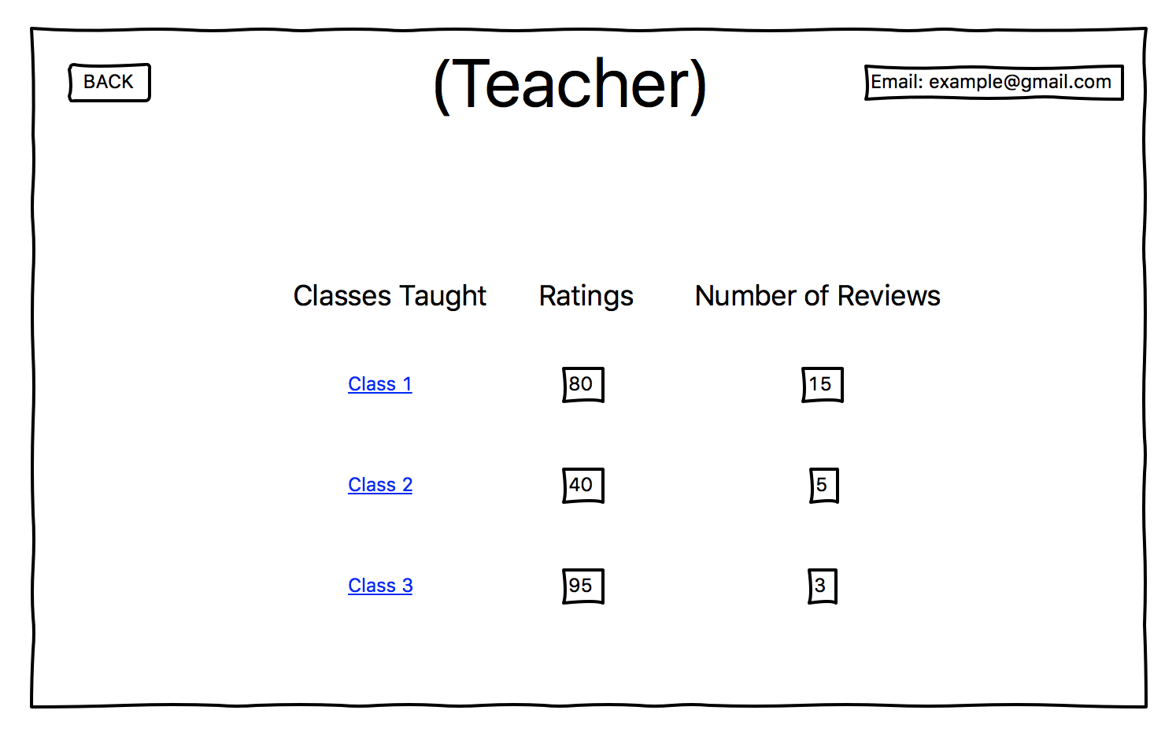
Wireframes

Slide 8
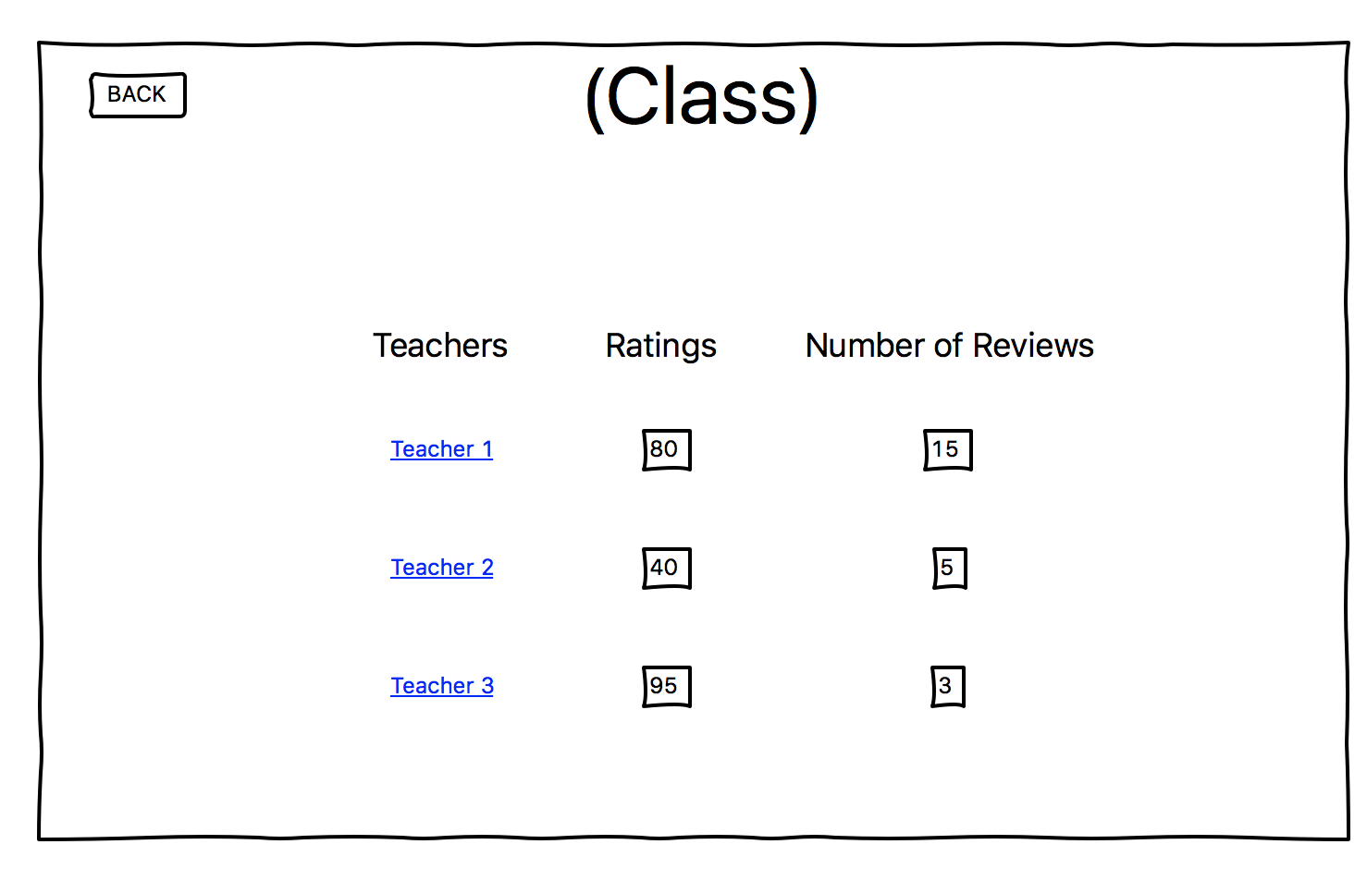
Wireframes

Slide 9
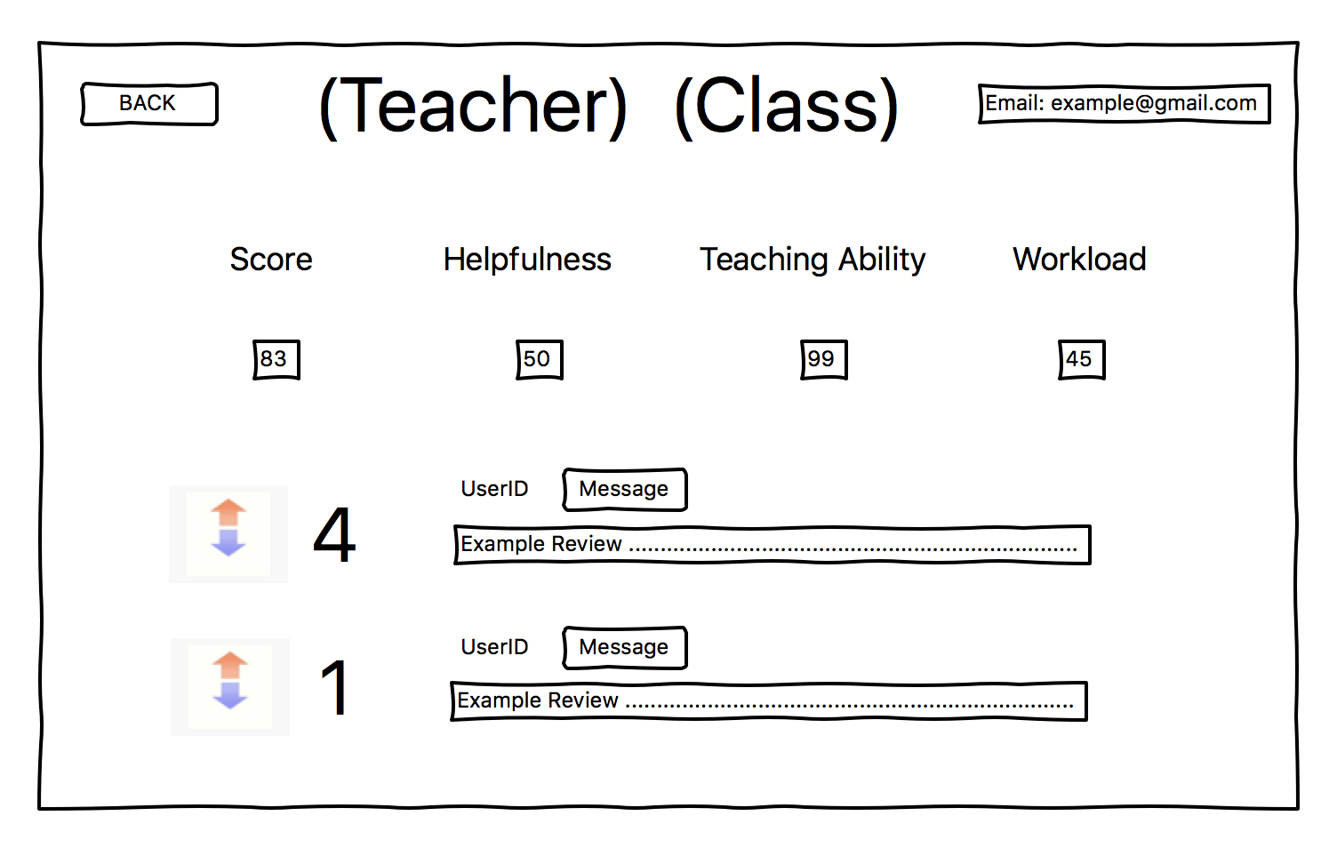
Wireframes

Slide 10
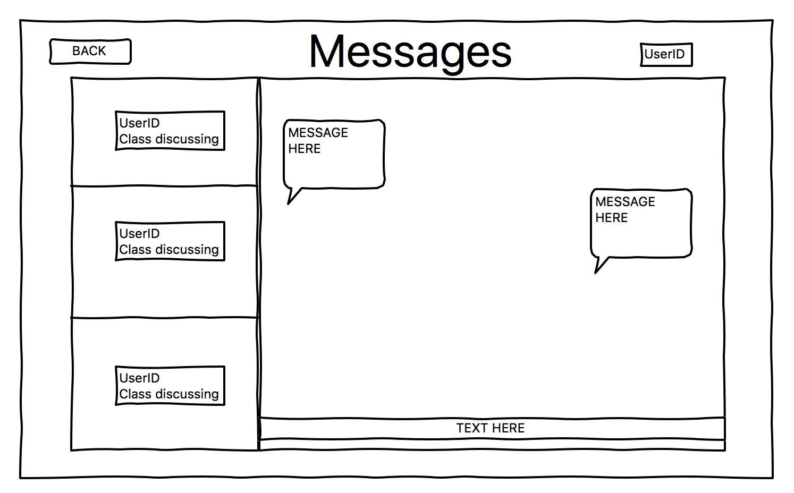
Wireframes

Slide 11
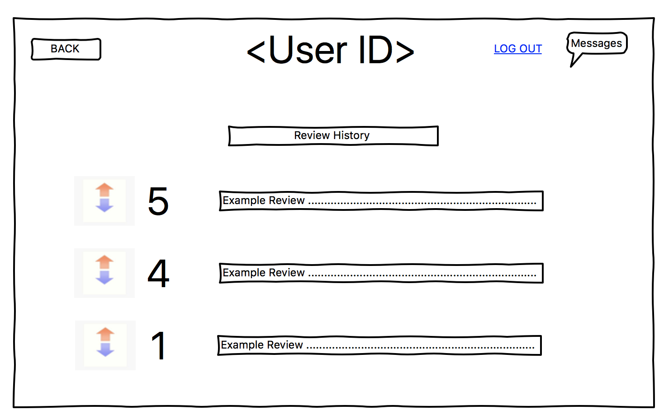
Wireframes

Slide 12
Requirements
Functional Requirements
Users need to be able to register an account.
Users must be able to search based on class.
Users must be able to see professor options after searching the class.
Users must be able to search based on professor.
Users must be able to write a review on a professor.
Users must be able to upvote or downvote a review.
Users must be able to send a message to the author of the review.
The reviewer must be able to respond to a message.
User must be able to log out.
The application must be able to sanitize user input.
User must be able to navigate bidirectionally in this application.
Users need to be able to delete an account.
Users must be able edit a review.
Non-Functional Requirements
- Messages must be able to be sent anonymously
- User data must be kept private
- Application must be fast for the average user
- Application must handle traffic of at most 20 users at once
- User interface should be intuitive
- User interface should be graphically pleasing

Slide 13


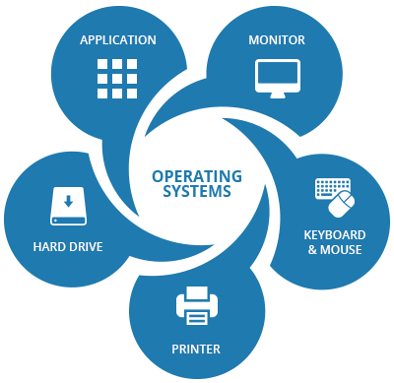
Actors
User Admin System

Slide 14
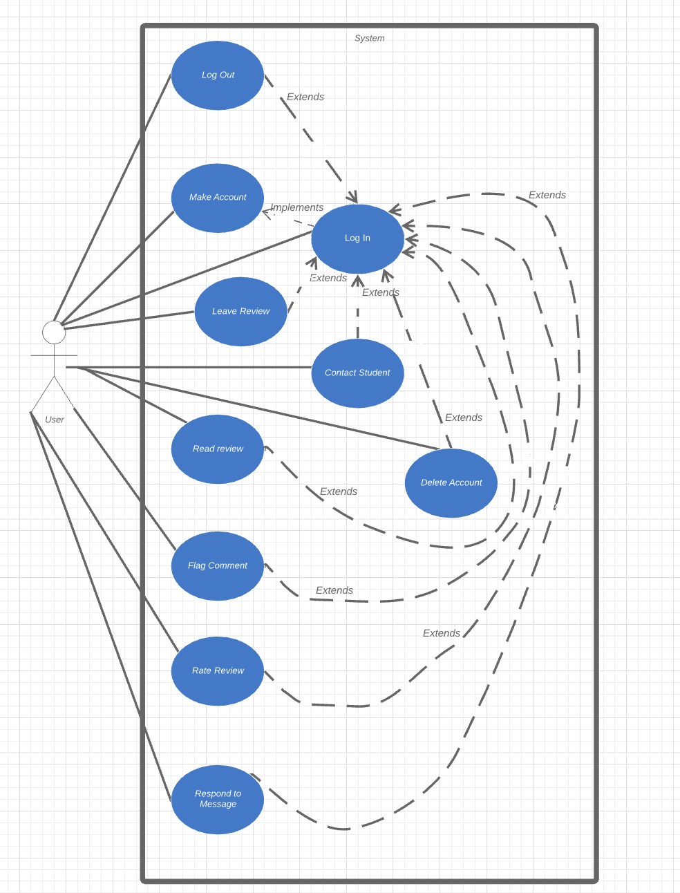
Use Case Diagram

Slide 15
Use Case Division
Use Cases handled by Kevin– Make Account, Respond to a Message, Flag Comment
Use Cases handled by Mark – Leave Review, Rate Review, Read Review
Use Cases handled by Connor – Contact Student, Edit Review, Delete Account, Log Out

Slide 16
Make Account
Make an Account
Scope: GCC Application
Level: User Goal
Primary Actor: Student
Stakeholders and Interests:
Student User: Wants username and password stored and hashed for security.
Preconditions: Student has loaded the site
Success Guarantee: Students data is hashed and saved into database. Immediate access to the application is granted.
Main Success Scenario:
Student loads application.
Student requests a new account.
Student enters Username, Password and, email, etc.
System updates valid students list with new student.
Student Logs in.
Alternative Flows:
a. At any time the student closes the application.
1. Interaction ends.
b. At any time system fails.
1. Student will restart application.
c. While student is on register page, they would like to login with valid credentials(the realized they had an account already)
1. Student clicks `return to login` and logs in with valid username and password.
d. Username and password from account creation do not work.
1. Prompt student to reset password with security question.
1.1. Student answers security question correctly
1.1.1. Student resets password.
1.2. Student does not answer security question correctly
1.2.1 Student is returned to login page.

Slide 17
Leave Review
Leave Review
Scope: GCC Application
Level: User Goal
Primary Actor: Student
Stakeholders and Interests:
Student User:
Wants Username and Password to be recognized.
Wants review to be saved for others to view
Student has valid login credentials
Preconditions:
Student has loaded the program.
Success Guarantee:
Student review is made available to other users on the site.
Main Success Scenario:
Student loads application.
Student logs in.
Student selects professor they would like to review from drop-down menu
Student is brought to professors review page
Student writes review
Student saves review
Alternative Flows:
a. At any time the student closes the application.
1. Interaction ends.
b. At any time system fails.
1. Student will restart application.
c. Student picks wrong professor
1. Student clicks `back`
2. Selects correct professor from drop-down list
d. Username and password do not work.
1. Prompt student to reset password with security question.
1.1. Student answers security question correctly
1.1.1. Student resets password.
1.2. Student does not answer security question correctly
1.2.1 Student is returned to login page.
Mark Fuller, Kevin Kulda, Connor Woodahl --- https://github.com/markfuller/BNU

Slide 18
Contact Student
Contact Student
Scope: GCC Application
Level: User Goal
Primary Actor: Student
Stakeholders and Interests:
Student User:
Wants Username and Password to be recognized.
Wants review to be saved for others to view
Wants contact with other Student to be over message board
Preconditions:
Student has loaded the program.
Student has valid login credentials
Success Guarantee:
Student is able to message other Student user (two-way anonymity)
Main Success Scenario:
Student loads application.
Student logs in.
Student selects professor they would like to view reviews of
Student is brought to professors review page
Student selects, contact reviewer button
Student creates message
Student Sends message
Opposing student responds to message
Message Notification shows up on login of user
Alternative Flows:
a. At any time the student closes the application.
1. Interaction ends.
b. At any time system fails.
1. Student will restart application.
c. Student picks wrong professor
1. Student clicks `back`
2. Selects correct professor from drop-down list
d. Username and password do not work.
1. Prompt student to reset password with security question.
1.1. Student answers security question correctly
1.1.1. Student resets password.
1.2. Student does not answer security question correctly
1.2.1 Student is returned to login page.
Mark Fuller, Kevin Kulda, Connor Woodahl --- https://github.com/markfuller/BNU

Slide 19
Casual Use Cases
Respond to a Message
Main Success Scenario
The user clicks on the message board icon on the main page. Selecting the message they want to respond to, they use the messing capability of the application to respond to the message.
Alternative Success Scenario
Edit Review
Main Success Scenario
The user logs in and navigates to their profile where all their reviews are listed. Using the editor, they change the content of their review and save changes.
Alternative Success Scenario The user logs in and navigates to their review by selecting the professor and finding their review under the professors page. Using the editor, they change the content of their review and save changes.
Delete Account
Main Success Scenario
While the user is logged in, the user navigates to their user profile settings and select the delete account button. After confirming your selection they are logged out.
Alternative Success Scenario
Rate Review
Main Success Scenario
User logs in with valid credentials. Selects the professor and class to read reviews for. Clicking the up-vote button if the review is accurate will increase the reviews score.
Alternative Success Scenario
User logs in with valid credentials. Selects the professor and class to read reviews for. Clicking the down-vote button if the review is inaccurate will decrease the reviews score.
Flag Comment
Main Success Scenario
User logs in with valid credentials. Selects the professor and class to read reviews for. If a review is inappropriate or uses vulgar language, the users flags it.
Alternative Success Scenario
Read Review
Main Success Scenario
The user will login with valid credentials. Using the navigation page, selects a professor and the desired class to load reviews for. Reviews load in chronological order.
Alternative Success Scenario
User logs in with valid credentials. Using the navigation page, selects a class and the desired professor to load reviews for. Reviews load in chronological order.
Log Out
Main Success Scenario
While the user is logged in, the user navigates to their user profile settings and logs out.
Alternative Success Scenario
The user is automatically logged out when they close the application.
Mark Fuller, Kevin Kulda, Connor Woodahl --- https://github.com/markfuller/BNU

Slide 20
Git Hub page
Please see our Github page for the current versions of our development materials and the full repository of our project artifacts.
https://github.com/MarkFuller1/BNU/

Slide 21
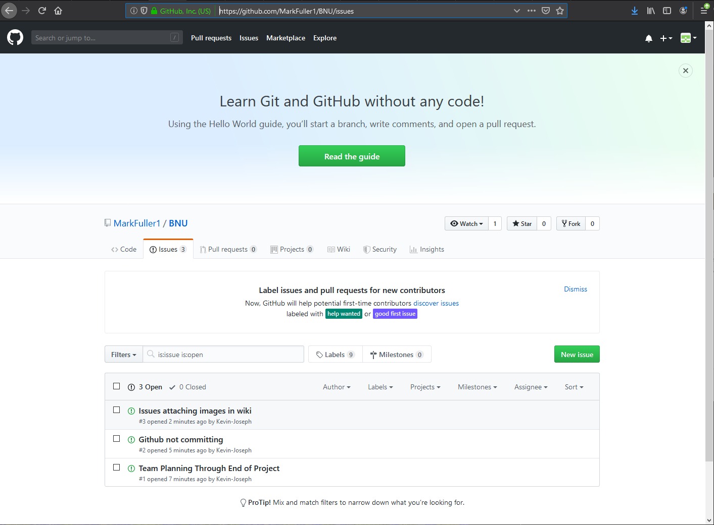
Issue Tracking
Please see our issue tracking repository on Github at the link below:
https://github.com/MarkFuller1/BNU/issues

Slide 22
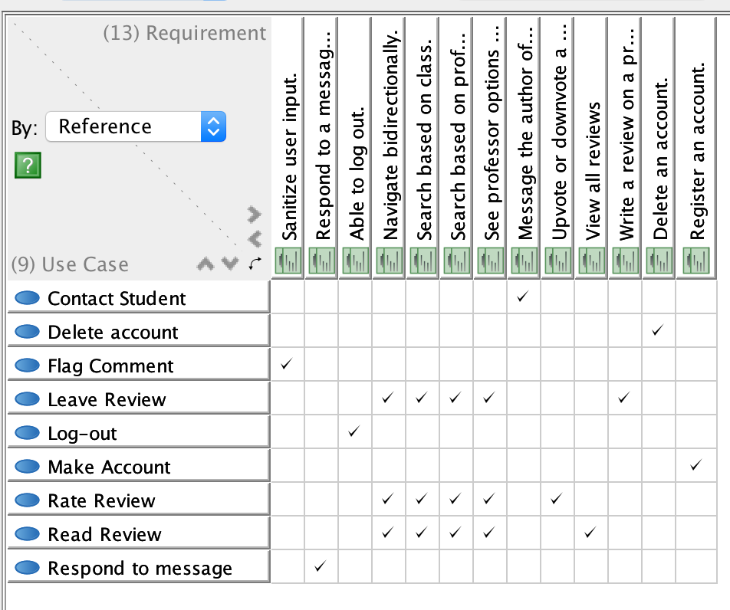
Traceability Matrix

Slide 23
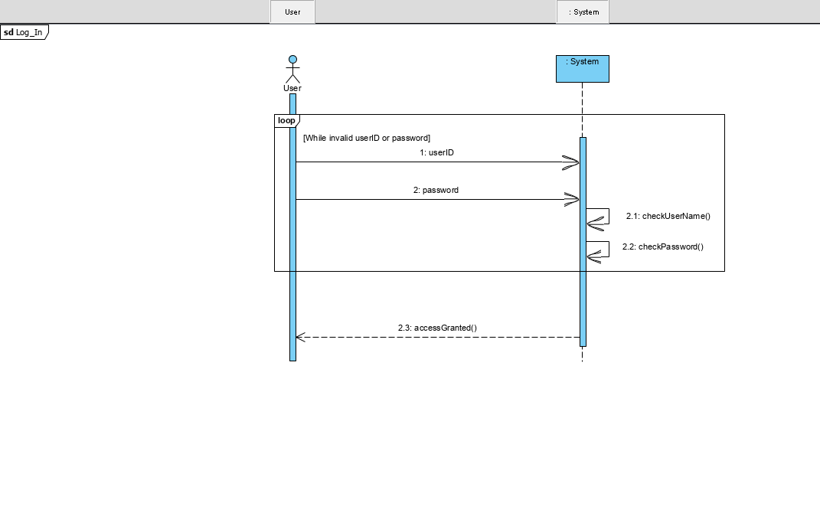
SSD

Slide 24
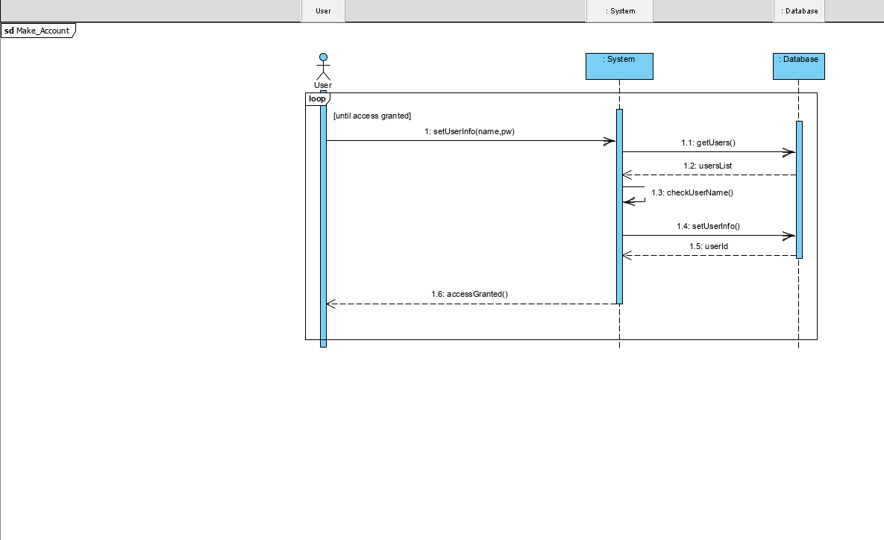
SSD

Slide 25
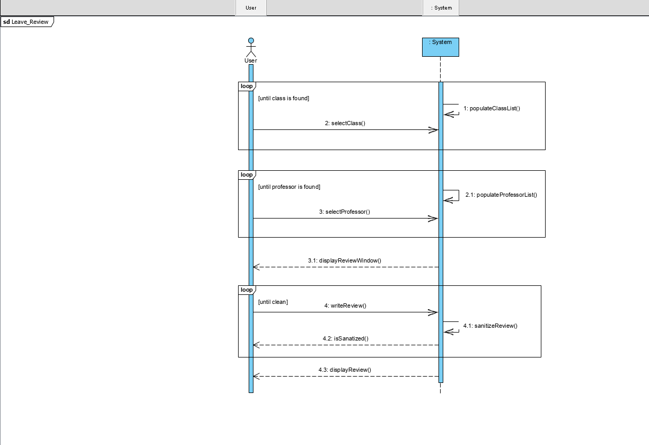
SSD

Slide 26
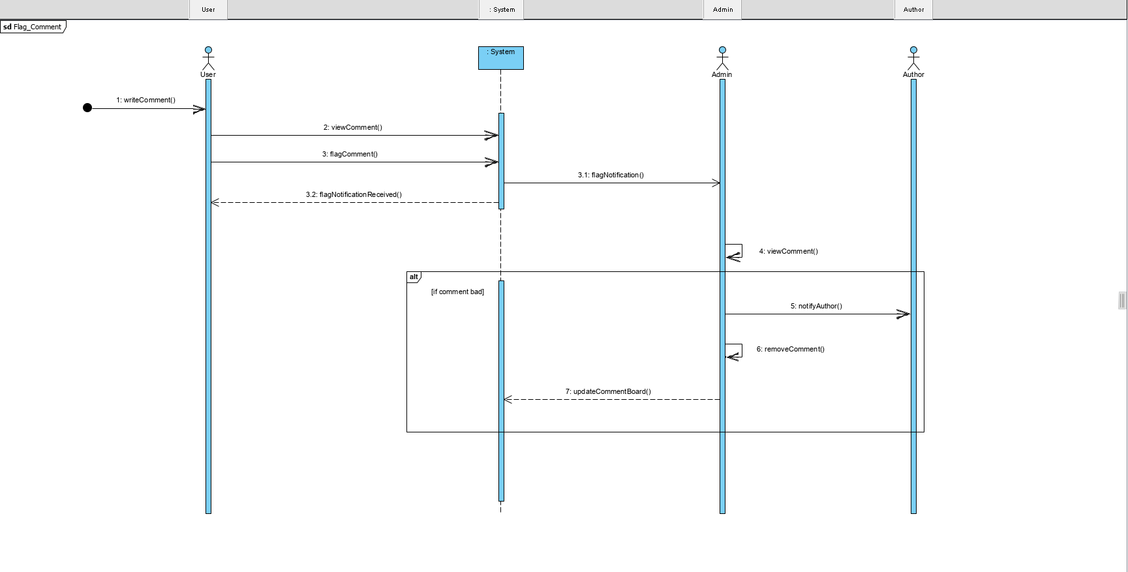
SSD

Slide 27
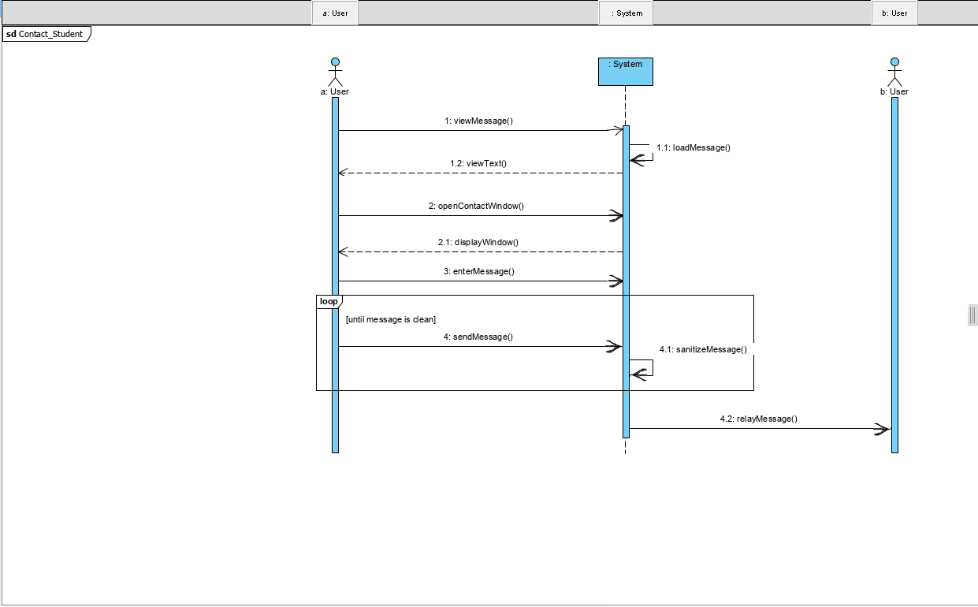
SSD

Slide 28
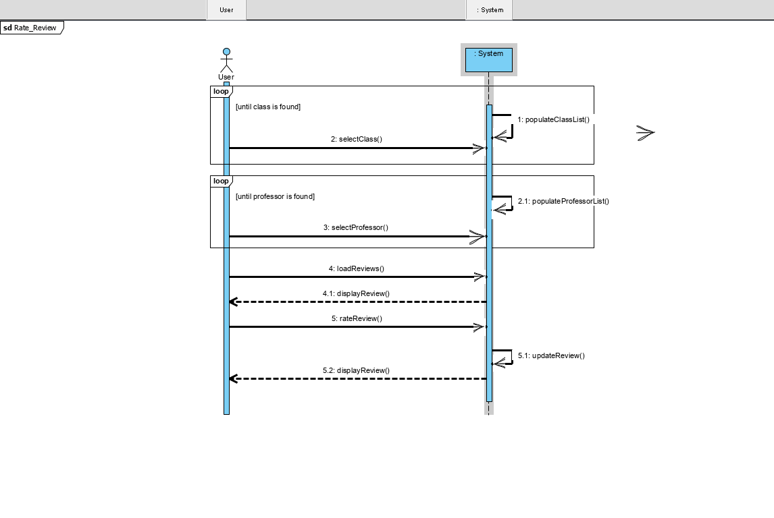
SSD

Slide 29
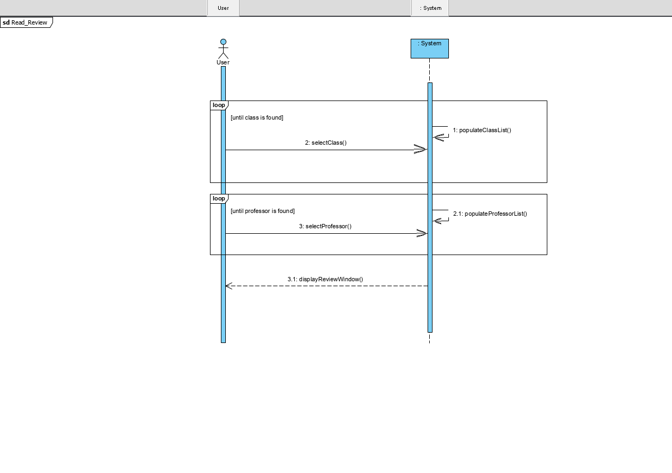
SSD

Slide 30
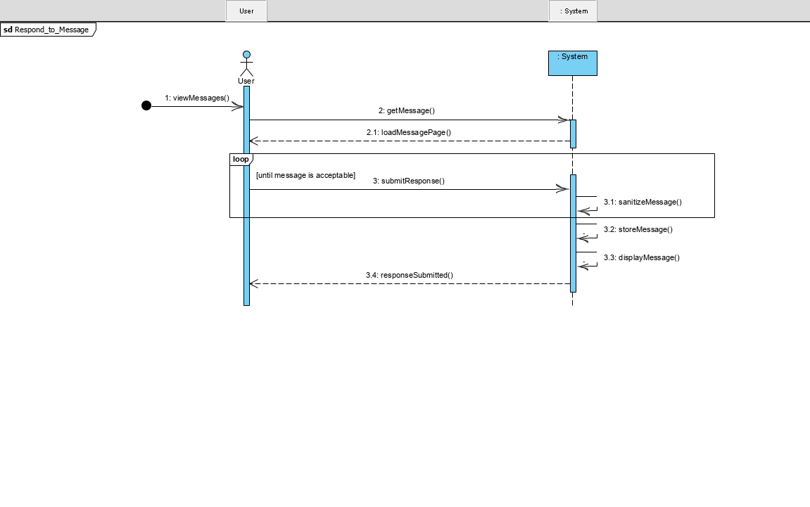
SSD

Slide 31
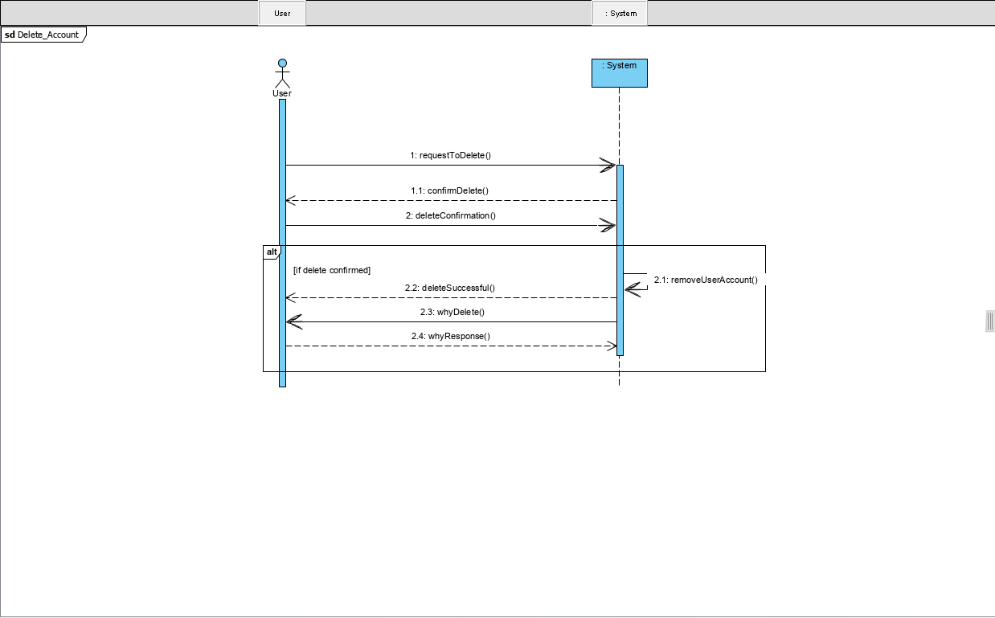
SSD

Slide 32
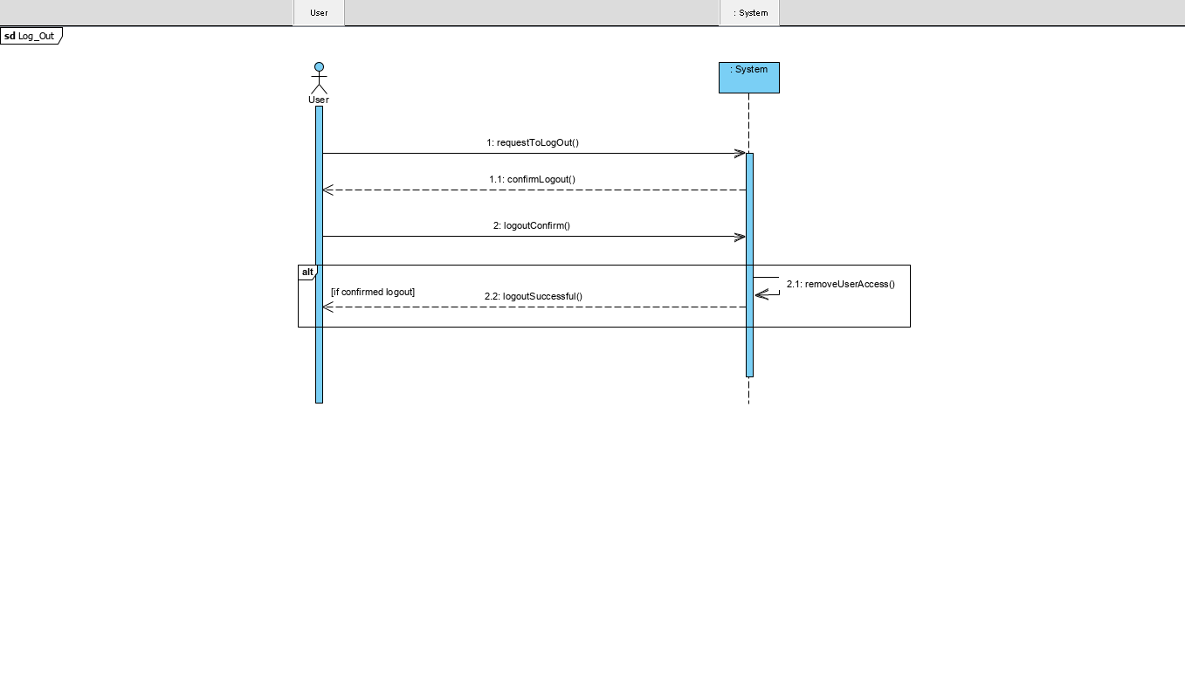
SSD

Slide 33
OPERATIONS
Defining the system operations helps us plan how we will implement the BCC application.
Examples
checkUsername()
checkPassword()
populateClassList()
populateProfessorList()
sendMessage()
viewMessage()
There are ~70 more ☺

Slide 34
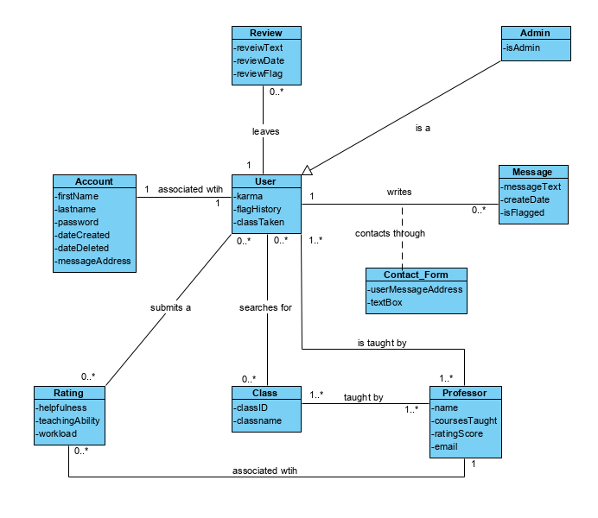
Domain Model

Slide 35
BCC Iteration 2
Mark Fuller
Kevin Kulda
Connor Woodahl
Project Repository: https://github.com/MarkFuller1/BNU

Slide 36
Application Interface

Slide 37
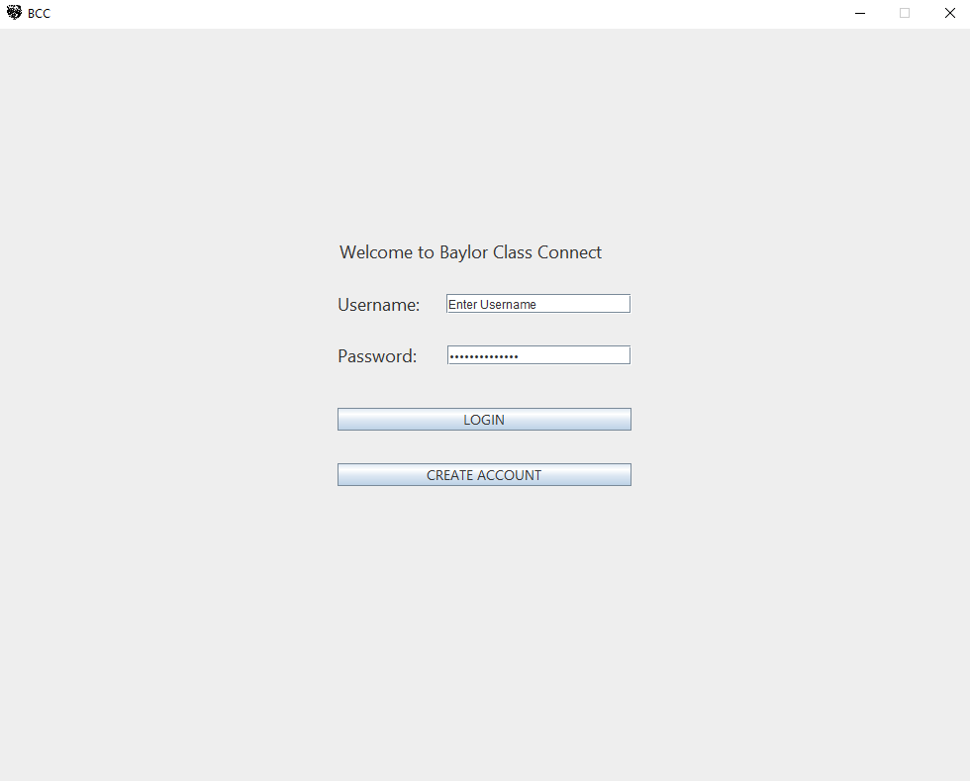
Login

Slide 38
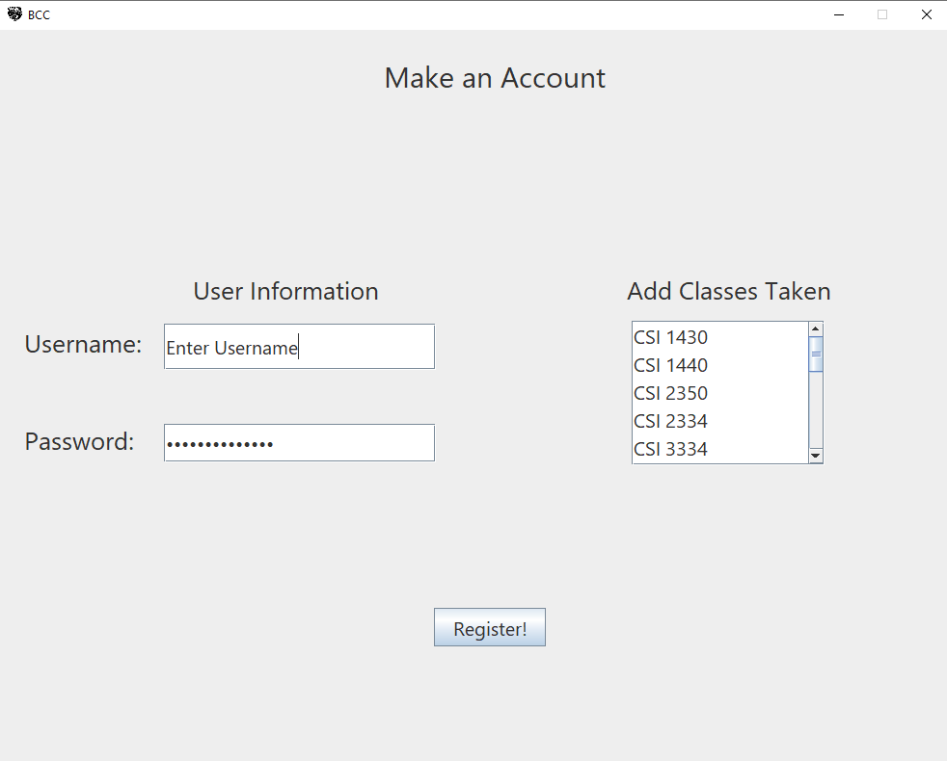
Register

Slide 39
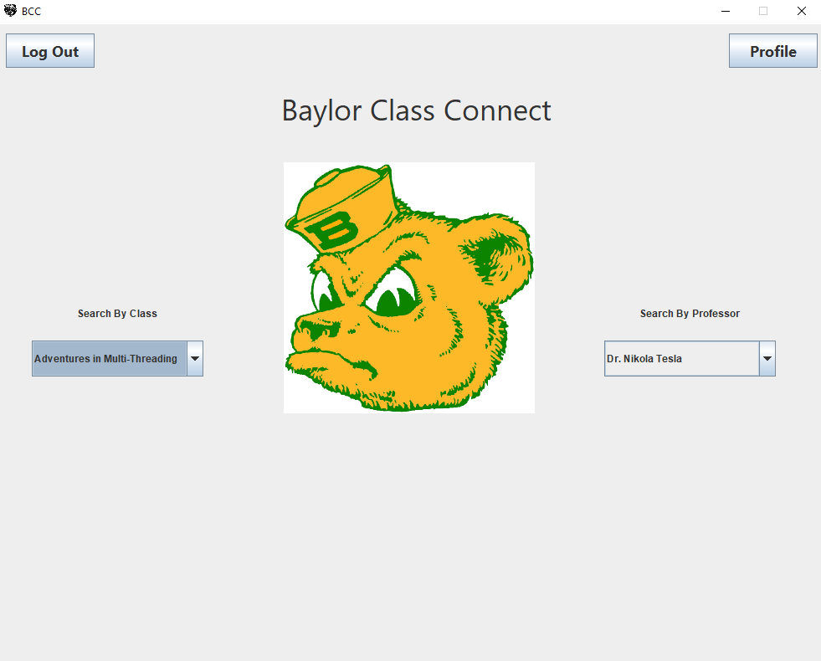
Main
Page

Slide 40
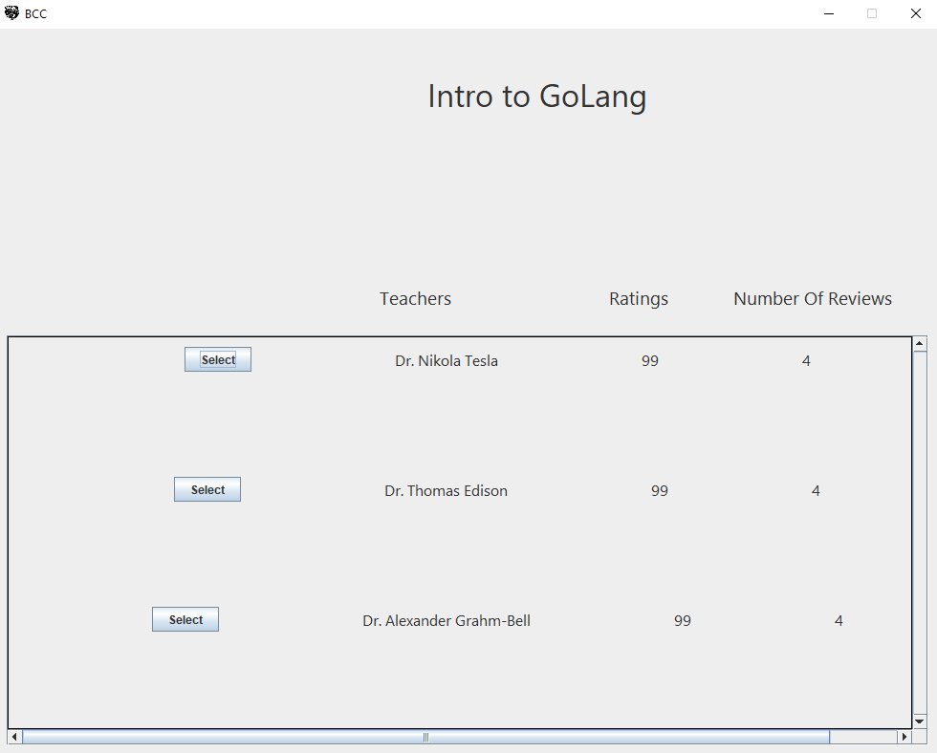
Search by Class

Slide 41
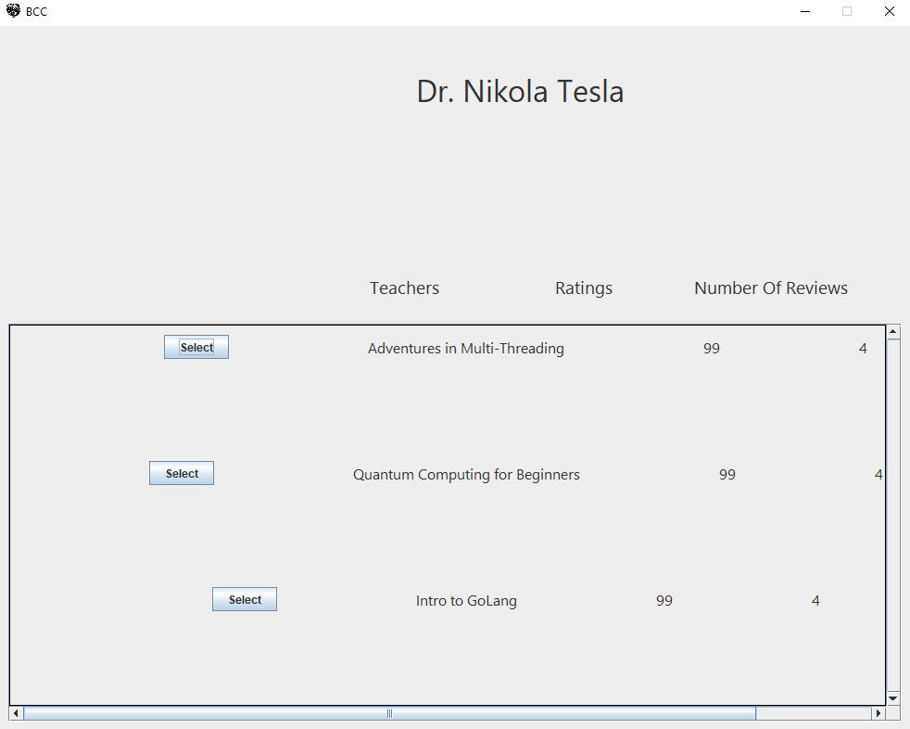
Search by Professor

Slide 42
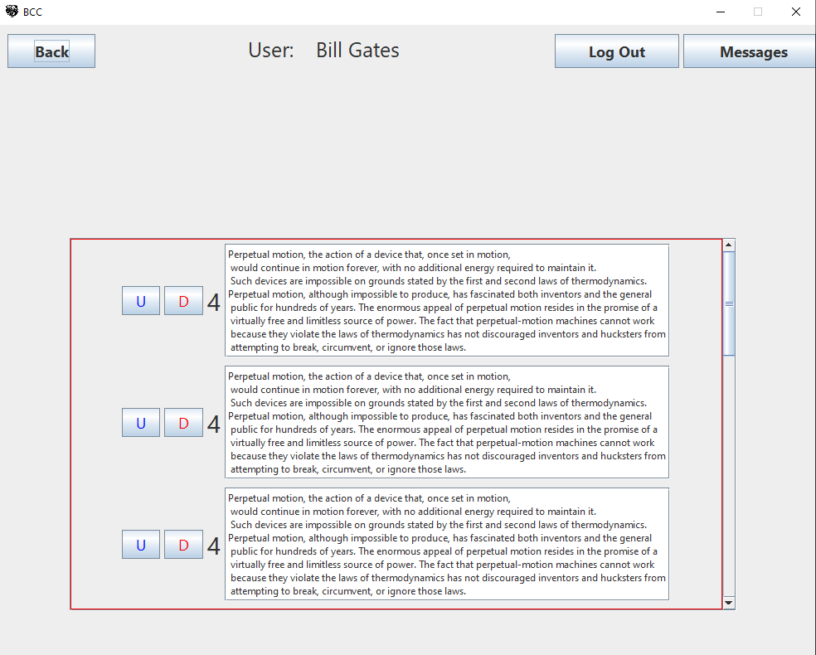
User Reviews

Slide 43
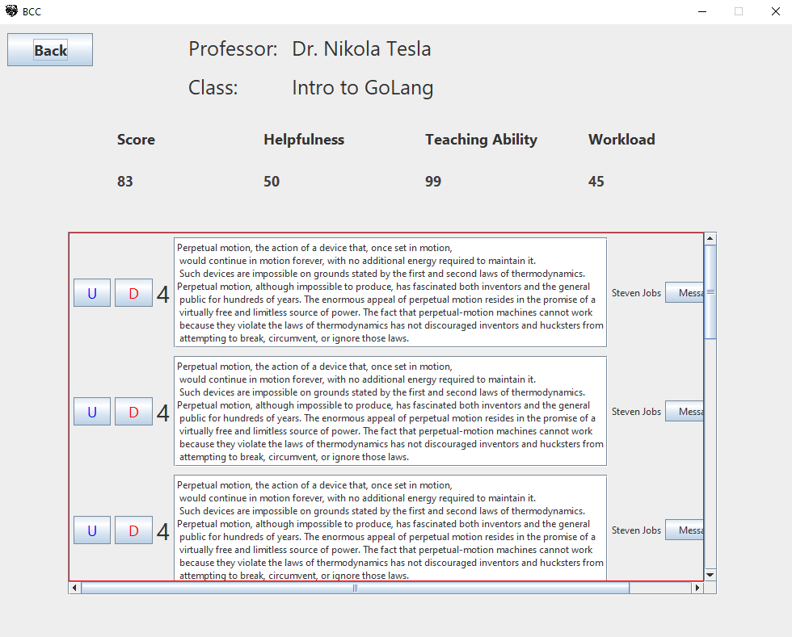
Class Reviews

Slide 44
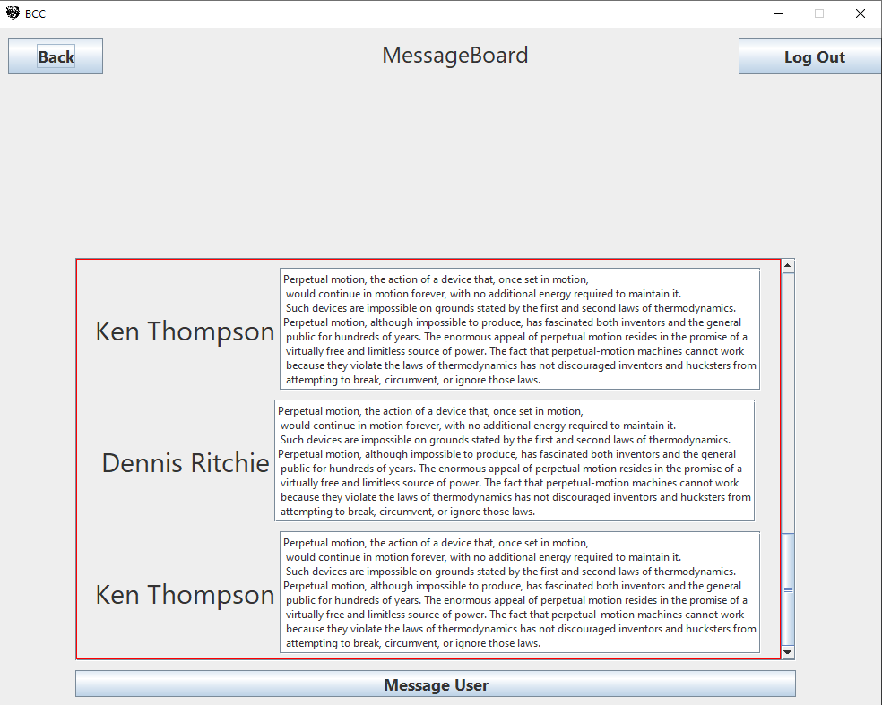
Message Board

Slide 45
Sequence Diagrams

Slide 46
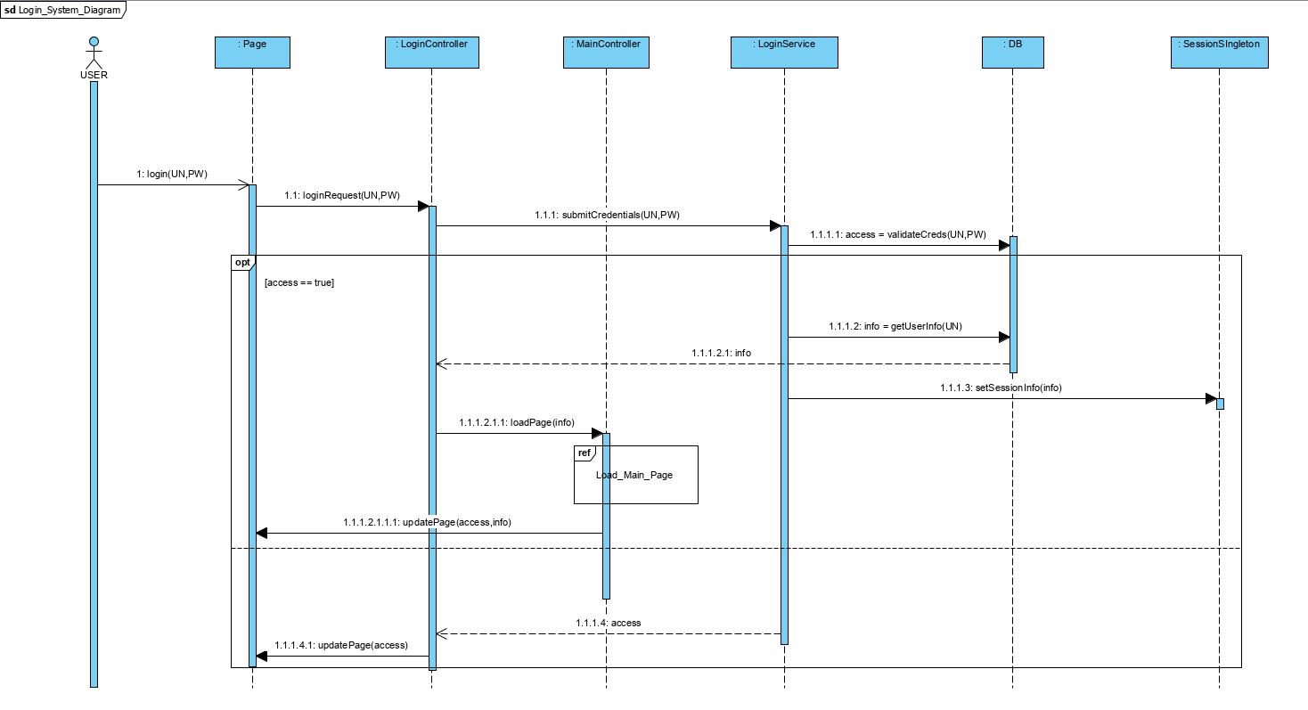

Slide 47
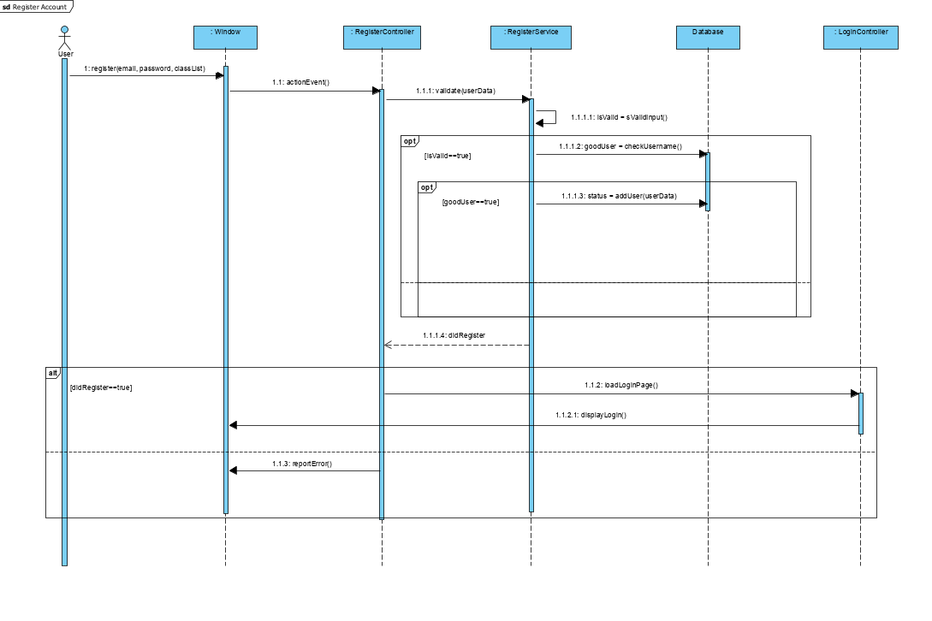

Slide 48
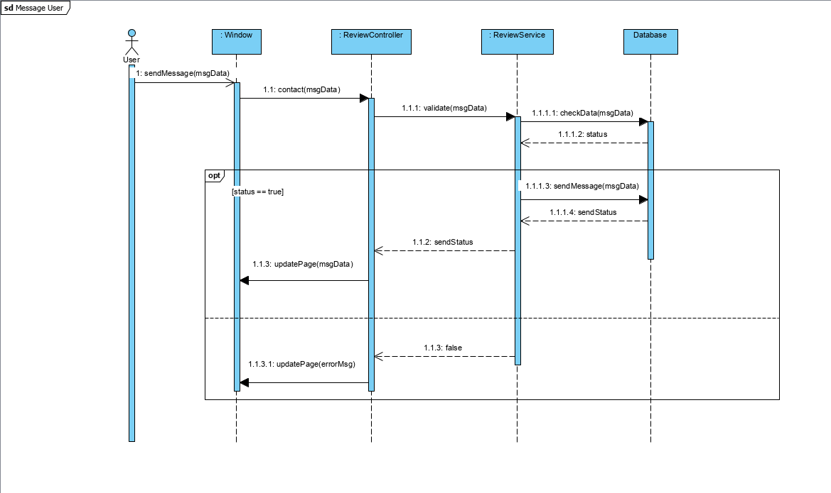

Slide 49
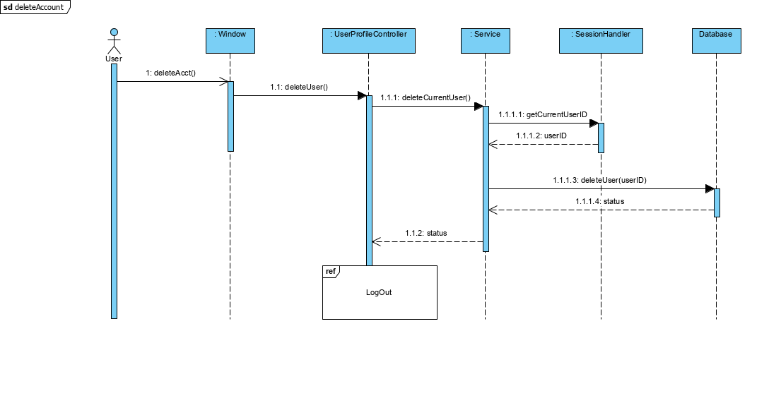

Slide 50
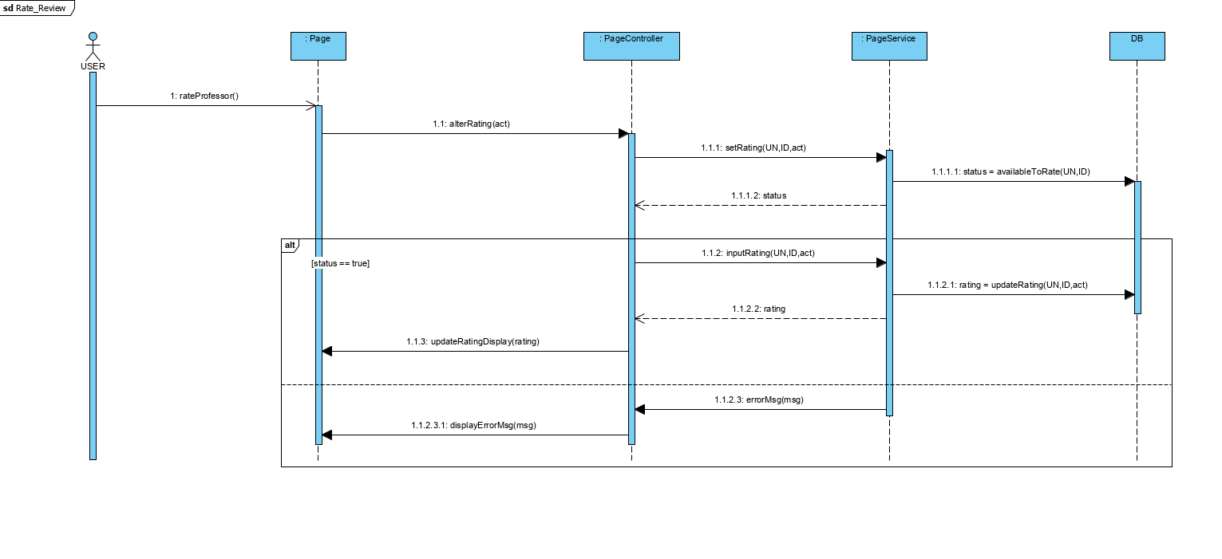

Slide 51
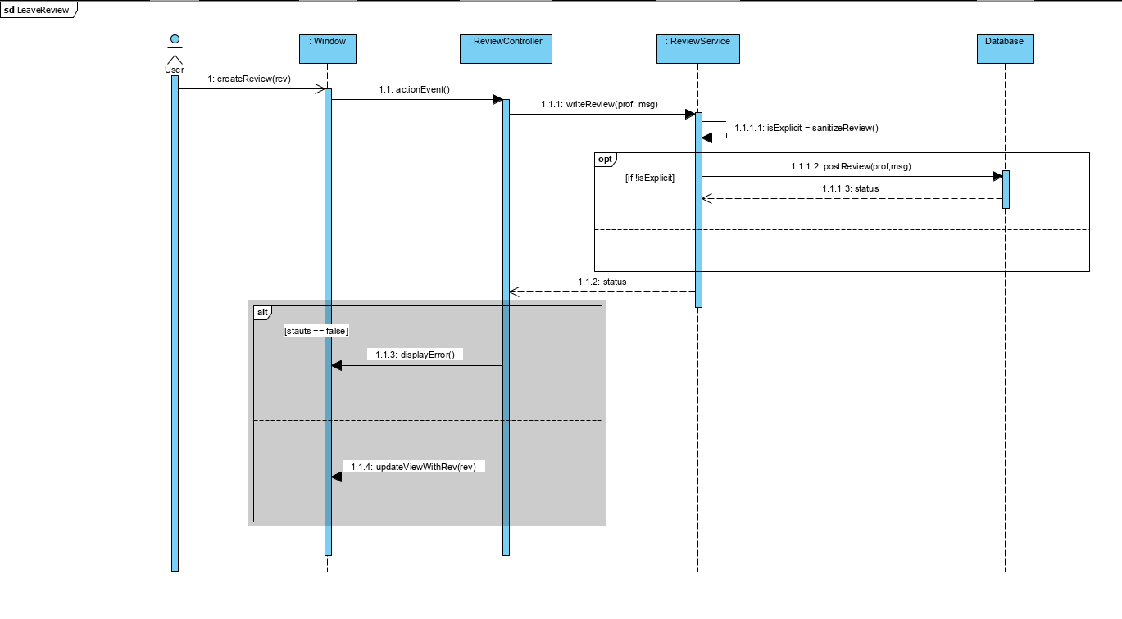

Slide 52
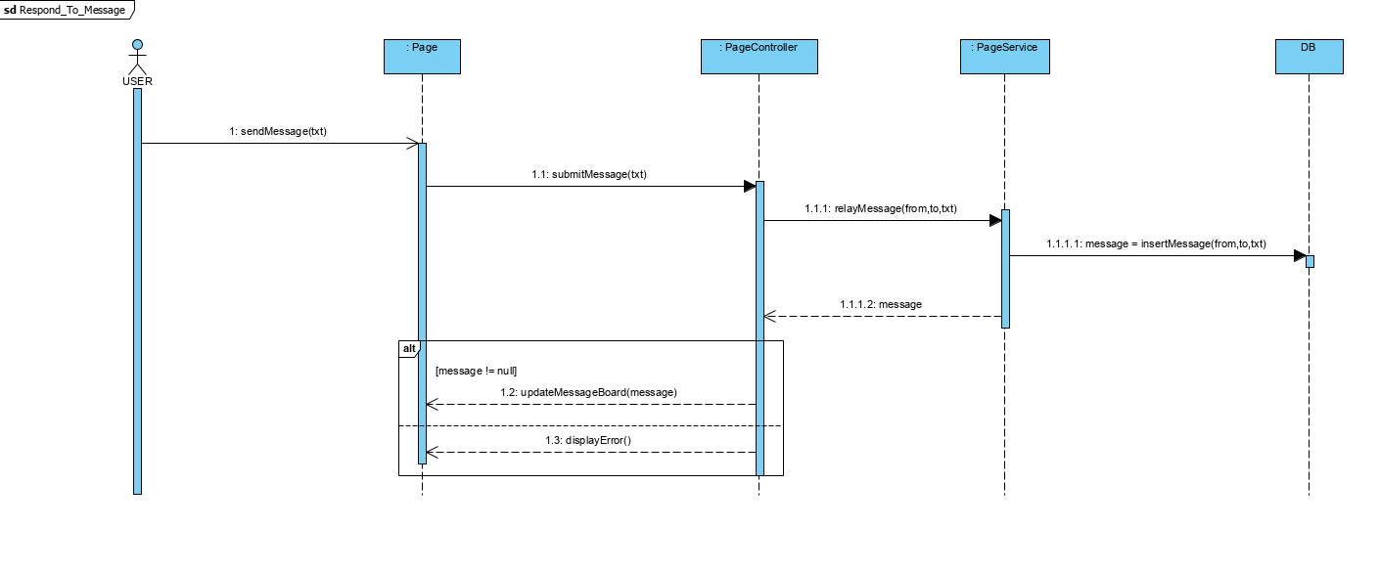

Slide 53
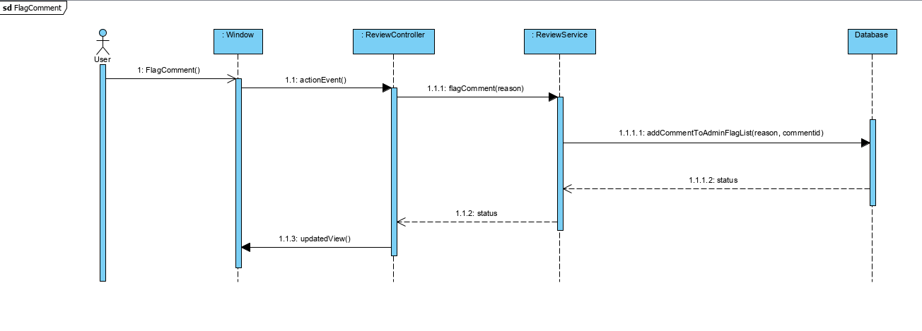

Slide 54
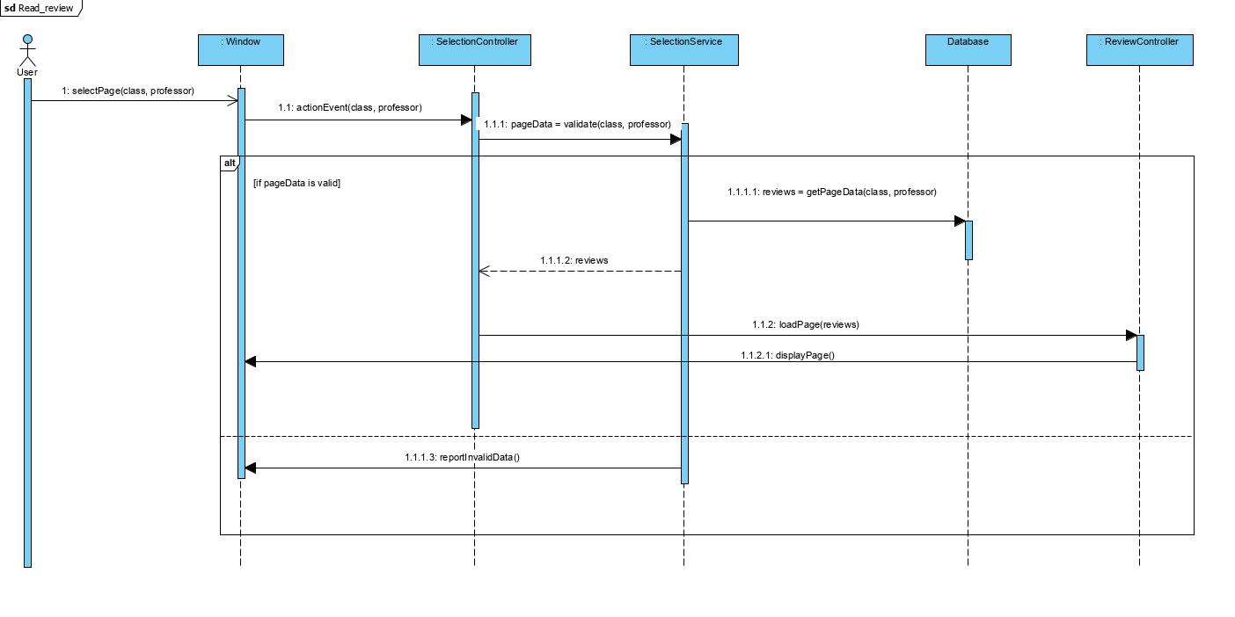

Slide 55
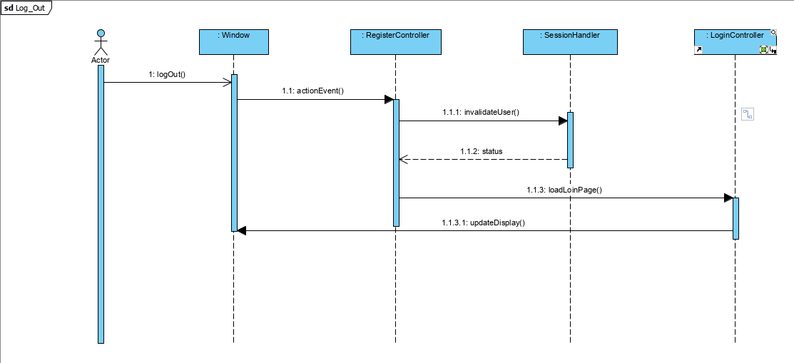

Slide 56
Design Class Diagram

Slide 57
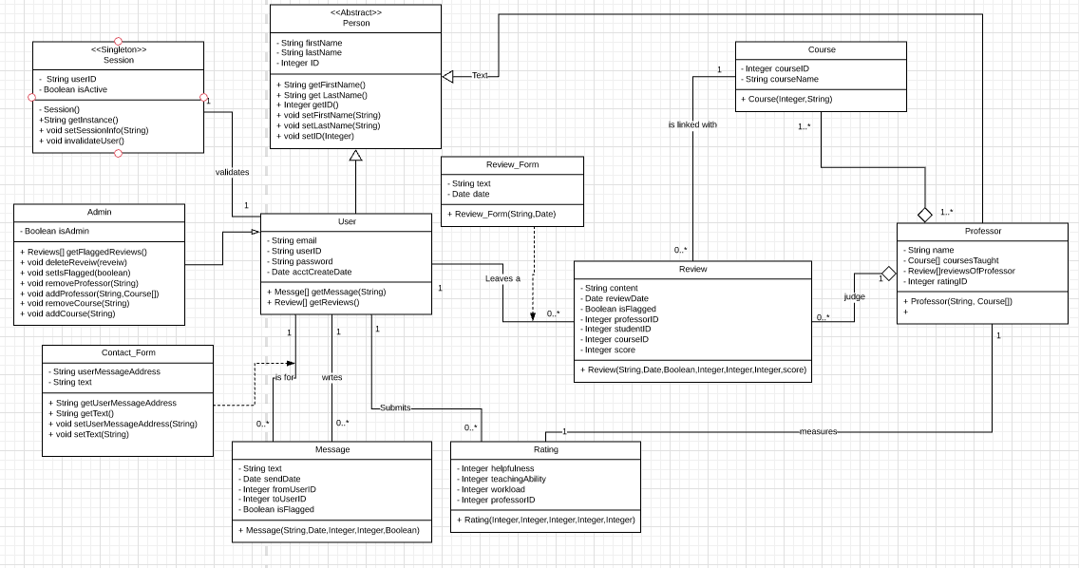
BCC Application

Slide 58
Iteration 2 Package Diagram

Slide 59
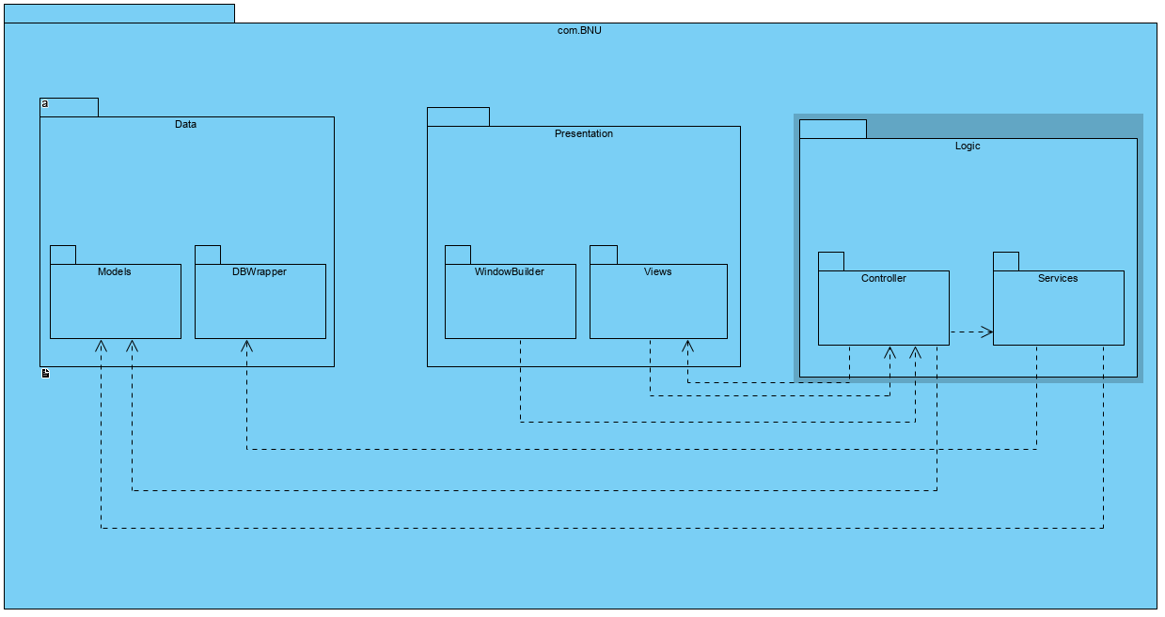

Slide 60
Doxygen Project Documentation

Slide 61
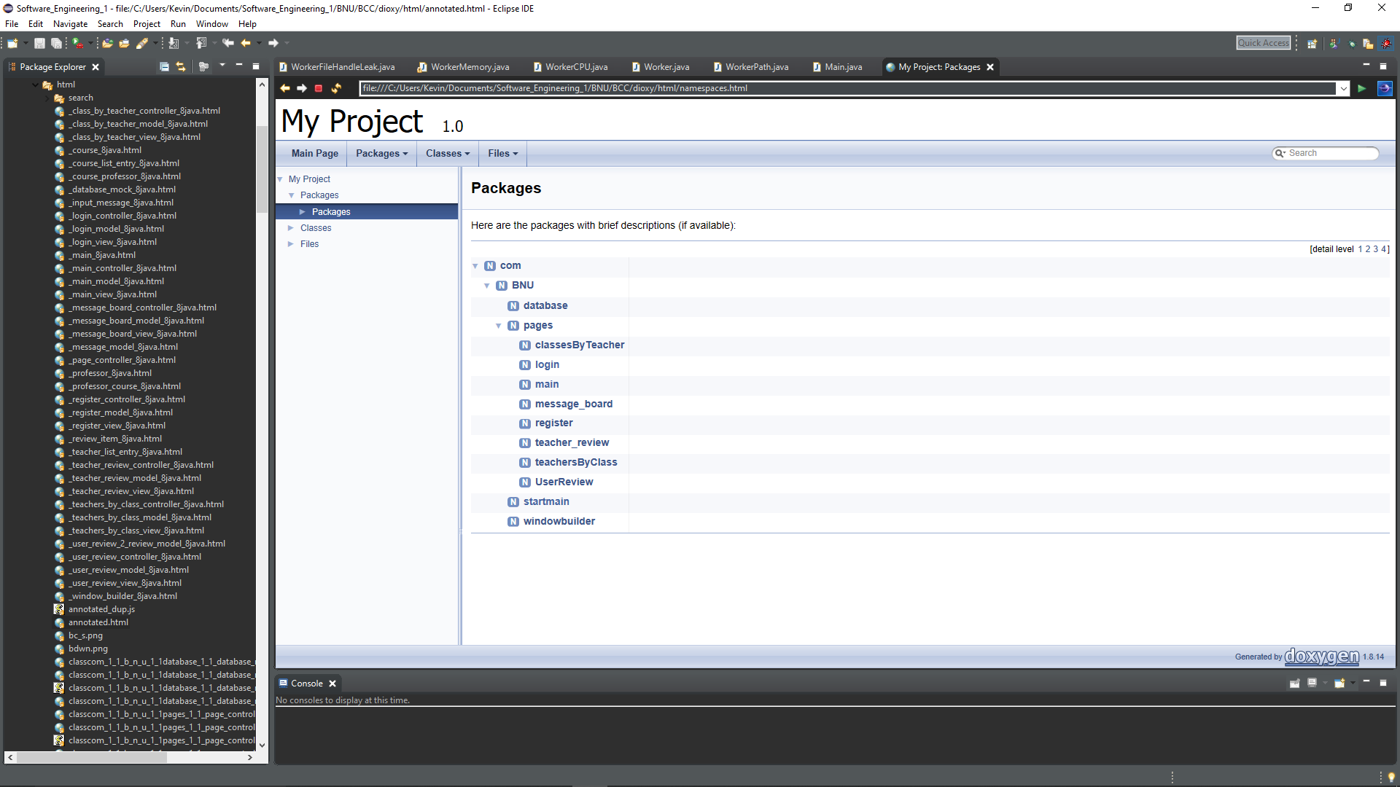

Slide 62
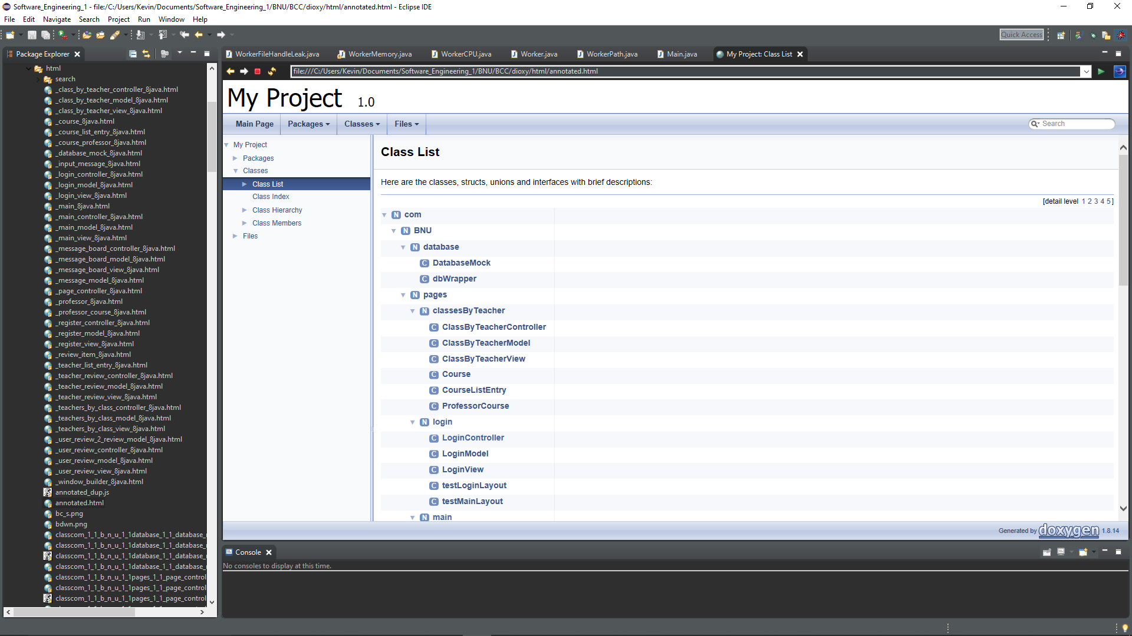

Slide 63
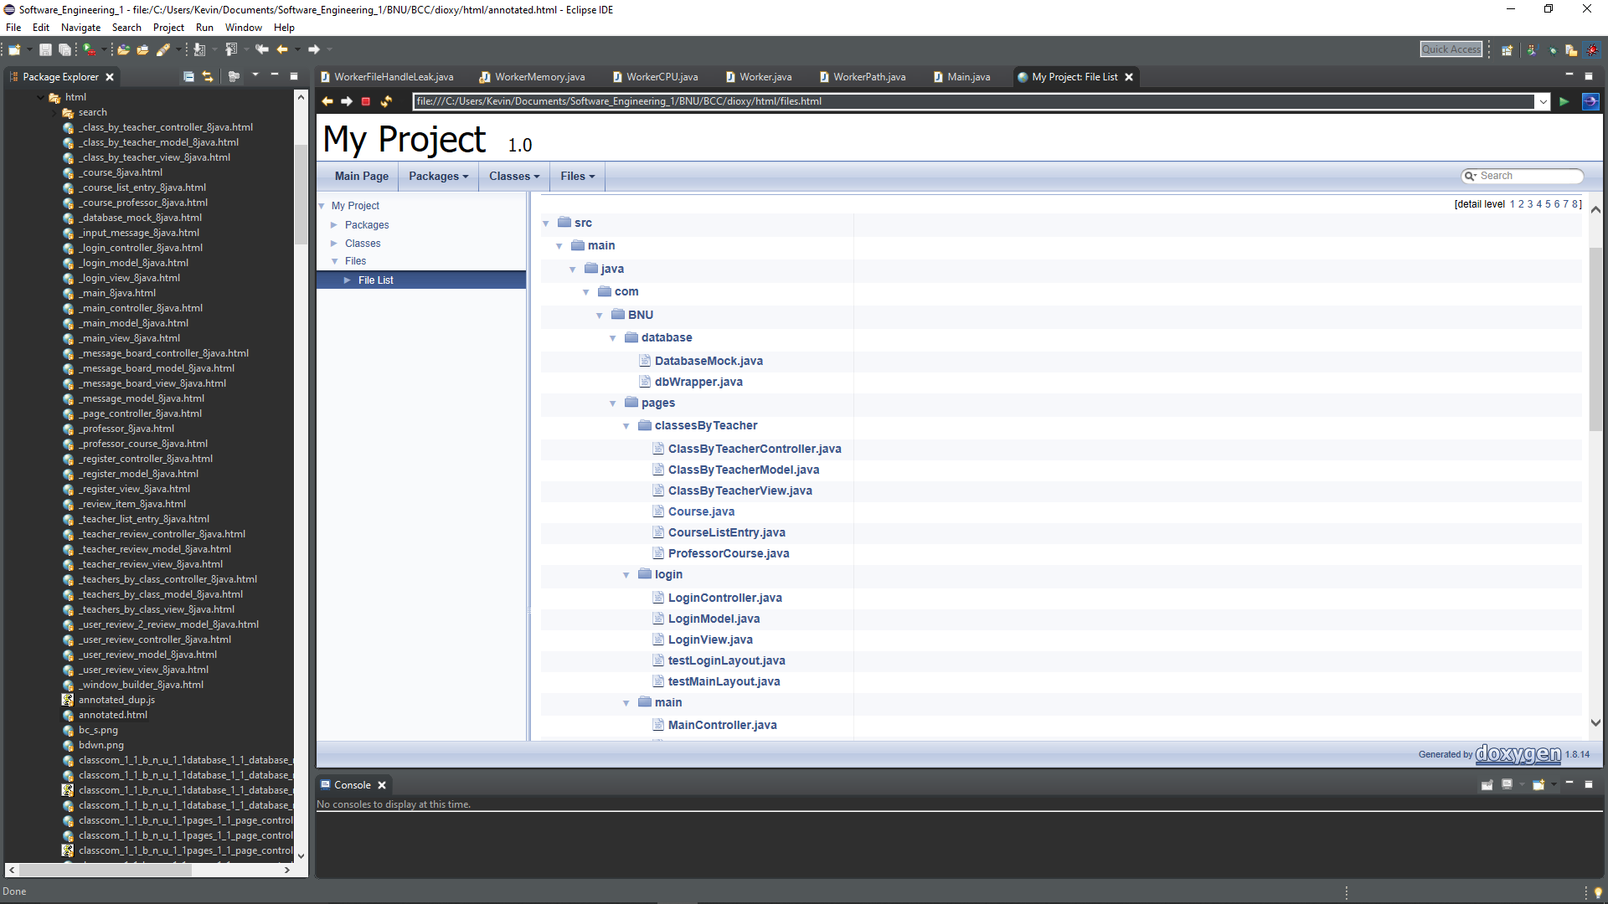

Slide 64
Project Planning

Slide 65
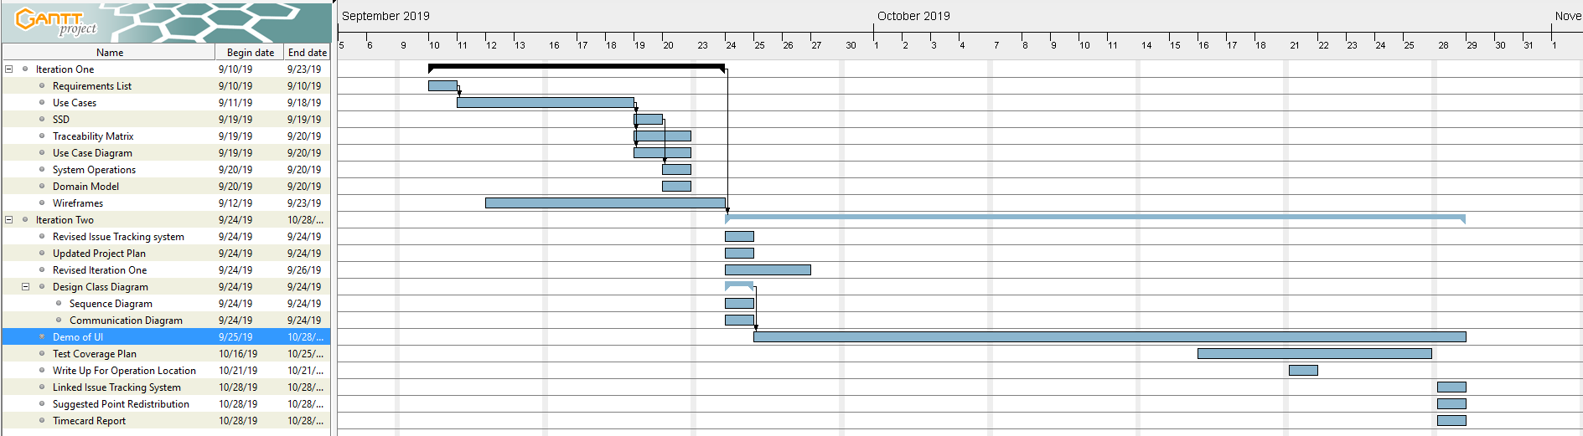

Slide 66
Grasp Justification
Each page is an individual package containing all the functionality needed required to load that page. Using the MVC model we are able to atomize the datatypes, logic, and view of each page.
Each pages Controller contains instances of the view, model, and panel that that page will display, as well as a reference to the database where data can be fetched for displaying.
Each Model contains the datatypes required to build the page. If the model represents a Java Swing pane then it contains mostly the JComponents that will be displayed on that page.
Each View builds the model JComponents into the pane that is stored by the Controller.
The database is currently wrapped with an API that will mimic the database when it is fully implemented. However it is currently hard-coded.

Slide 67
Coverage Plan
Each Controller and View will have test classes dedicated to them.
The Model currently has no implementation other than getters and setters, therefore does not need a testing suite.
The View of each page will be tested for loading errors by mocking the Controller for values.
The Controller will be tested using a mocked view to check for valid GUI generation and exception handling, It will also have tests for the functionality it contains within itself for database query routing.

Slide 68
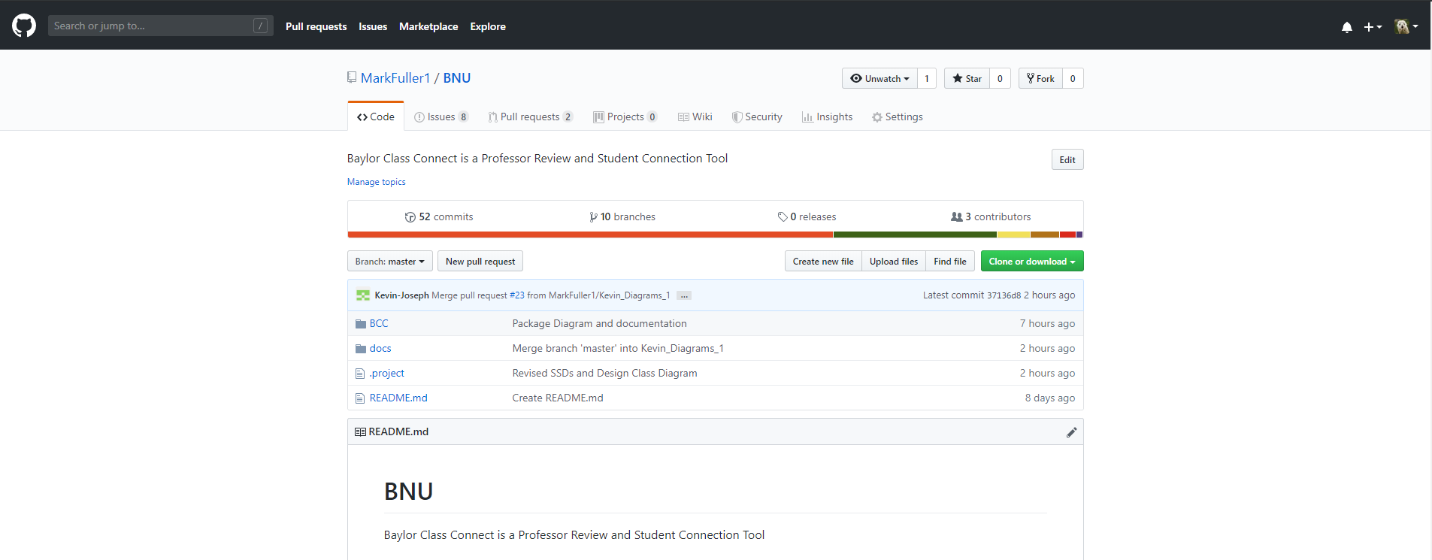
Git Repository
Repository Link: https://github.com/MarkFuller1/BNU/

Slide 69
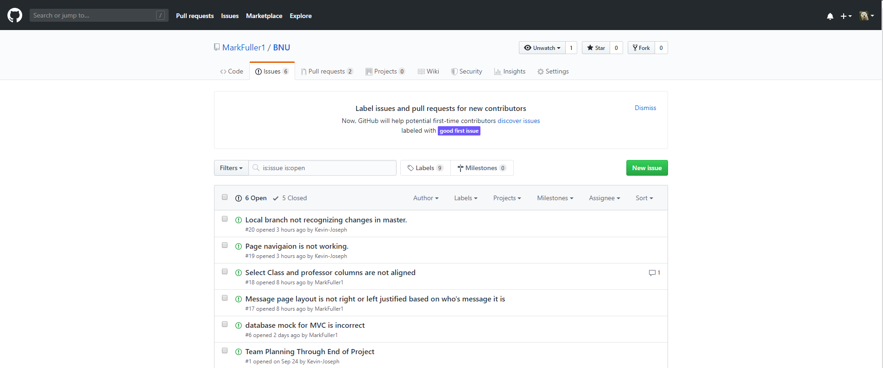
Issue Tracking
Repository Link: https://github.com/MarkFuller1/BNU/issues

Slide 70
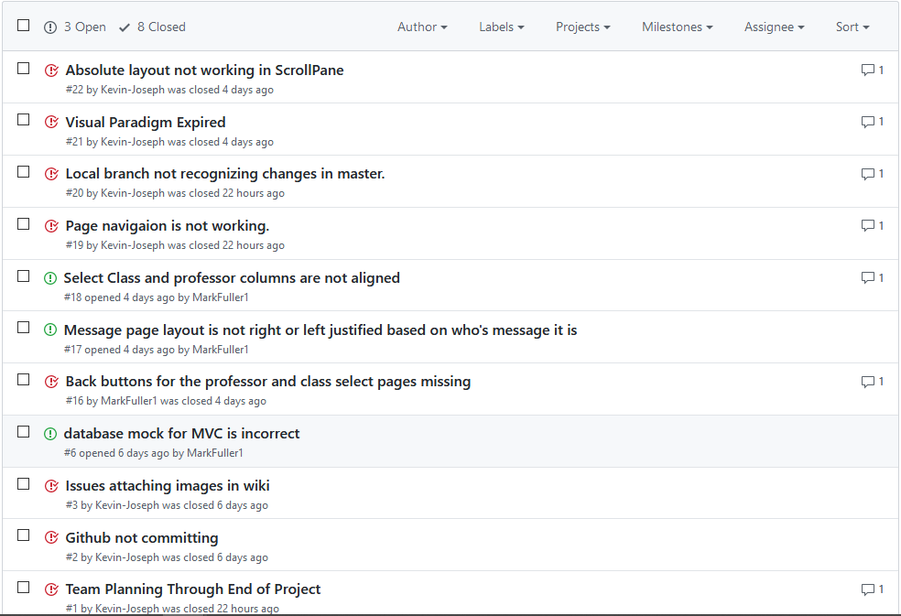
Repository Link: https://github.com/MarkFuller1/BNU/issues

Slide 71
BCC Iteration 3
Mark Fuller
Kevin Kulda
Connor Woodahl
Project Repository: https://github.com/MarkFuller1/BNU

Slide 72
Use Case Screenshots from GUI

Slide 73

Make Account

Slide 74


Leave Review

Slide 75

Contact Student

Slide 76

Respond to a Message

Slide 77

Edit Review

Slide 78

Delete Account

Slide 79

Rate Review

Slide 80
Flag Comment

Slide 81


Read Review

Slide 82

Log Out

Slide 83
Link to Use Case Video
https://youtu.be/wOC9_yUQSi8

Slide 84
Link to Application User Guide
https://github.com/MarkFuller1/BNU/wiki/User_Guide_For_BCC

Slide 85


Slide 86
Link to Download Project Jar
https://github.com/MarkFuller1/BNU/wiki/jar

Slide 87
Testing

Slide 88

Note: tests that are dependent on data in the database may fail if we altered the data during development.

Slide 89


Slide 90


Slide 91
Spot Bugs Static Code Analysis

Slide 92

Spot Bugs Screenshots

Slide 93

Spot Bugs Screenshots
Only 59 Identified Bugs

Slide 94

Spot Bugs Screenshots

Slide 95

Spot Bugs Screenshots

Slide 96

Spot Bugs Screenshots

Slide 97
7 Design Patterns

Slide 98

7 Design Patterns

Slide 99


Slide 100


Slide 101

Lazy Initialization

Slide 102

Bridge

Slide 103

Observer

Slide 104


Slide 105

Template Method

Slide 106


Slide 107


Slide 108

Package Diagram

Slide 109
Javadoc

Slide 110

JavaDocs

Slide 111

JavaDocs

Slide 112
Git Analysis

Slide 113
An hand analysis of contributions to this project:
GitHub Insights:
K
Mark Fuller: 58 hours
Kevin Kulda: 52 hours
Connor Woodahl: 55 hours

Slide 114


Slide 115


Slide 116


Slide 117


Slide 118


Slide 119


Slide 120
Time Tracking
Mark Fuller: 58 hours
Kevin Kulda: 52 hours
Connor Woodahl: 55 hours

Slide 121
Point Distribution
Mark Fuller: 33.4%
Kevin Kulda: 33.3%
Connor Woodahl: 33.3%

